Slide 1
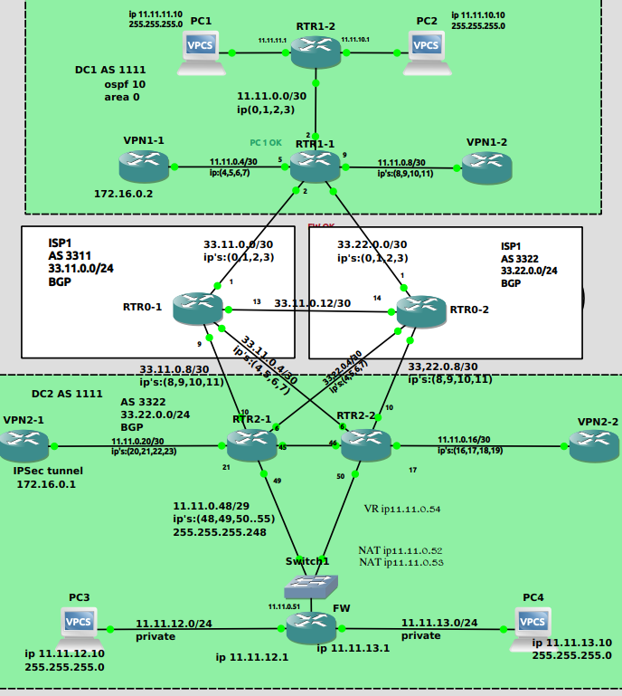
Network Configuration
in GNS3 APP
DC1:
PC1 - ip 11.11.11.10
PC2 - ip 11.11.10.10
DC2:
PC3 - ip 11.11.12.10
PC4 - ip 11.11.13.10

Slide 2
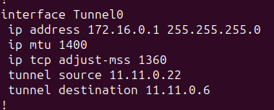
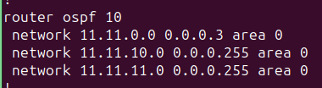
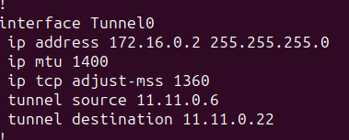
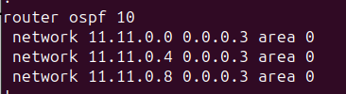
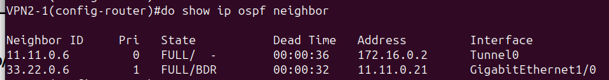
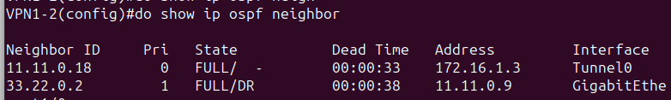
OSPF configs
Internet Protocol Security (IPsec)
Open Shortest Path First (OSPF)
VPN2-1
RTR2-2
VPN1-1
RTR1-1

Slide 3
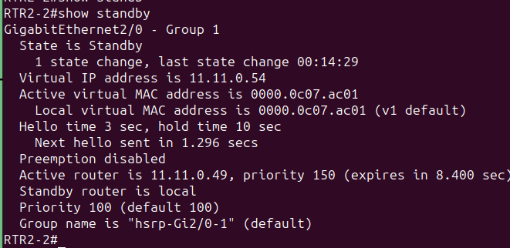
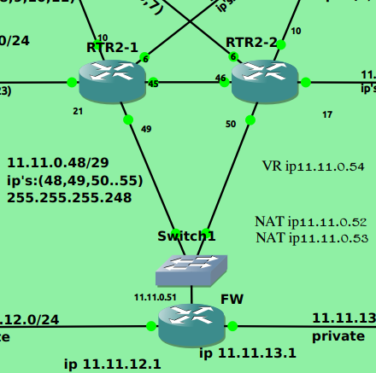
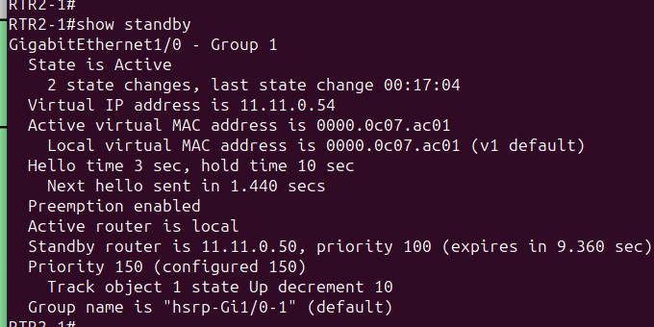
Hot Standby Router Protocol (HSRP) Virtual Router

Slide 4
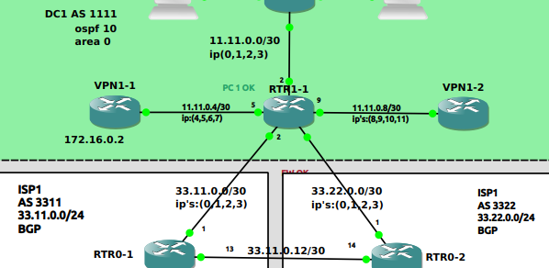
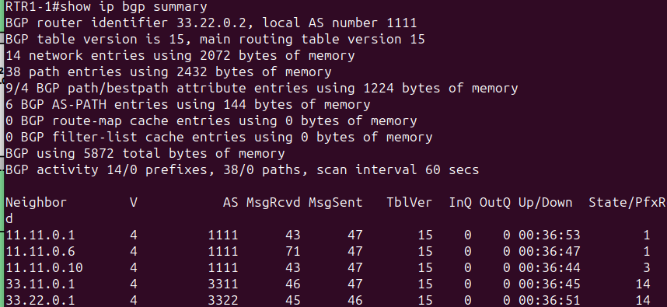
Border Gateway Protocol (BGP)
Internal BGP (IBGP)
External BGP (EBGP)
router bgp 1111
network 11.11.0.0 mask 255.255.255.252
network 11.11.0.4 mask 255.255.255.252
network 11.11.0.8 mask 255.255.255.252
network 33.11.0.0 mask 255.255.255.252
network 33.22.0.0 mask 255.255.255.252
neighbor 11.11.0.1 remote-as 1111
neighbor 11.11.0.6 remote-as 1111
neighbor 11.11.0.10 remote-as 1111
neighbor 33.11.0.1 remote-as 3311
neighbor 33.11.0.1 allowas-in
neighbor 33.22.0.1 remote-as 3322
neighbor 33.22.0.1 allowas-in

Slide 5
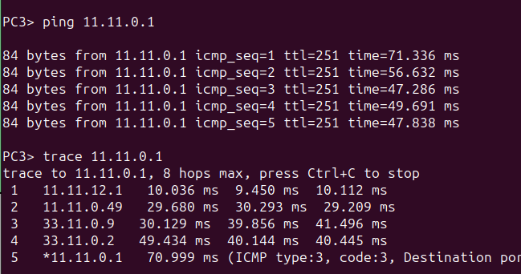
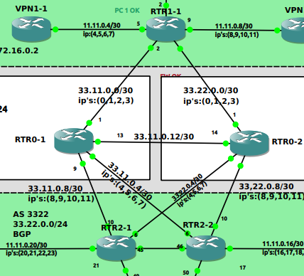
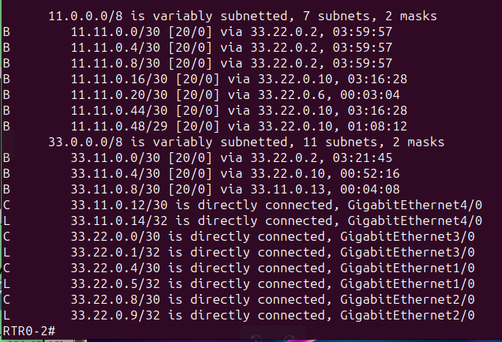
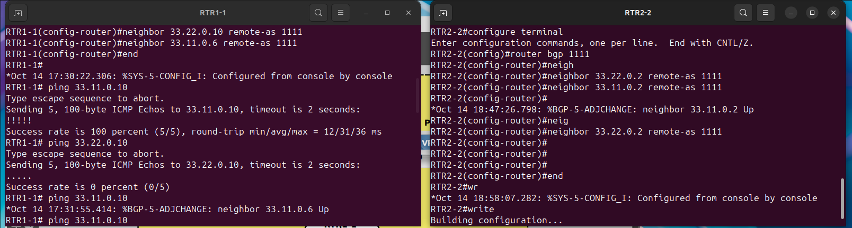
BGP settings
this case is working with:
no neighbor 33.22.0.1 allowas-in
no private subnets in ISP1, ISP2:
11.11.10.0/24
11.11.11.0/24
11.11.12.0/24
11.11.13.0/24

Slide 6


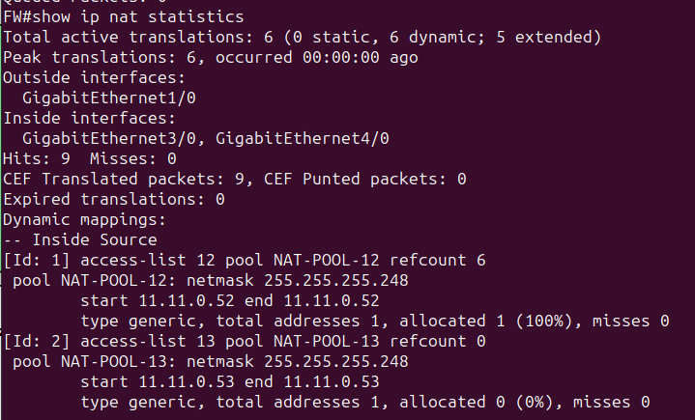
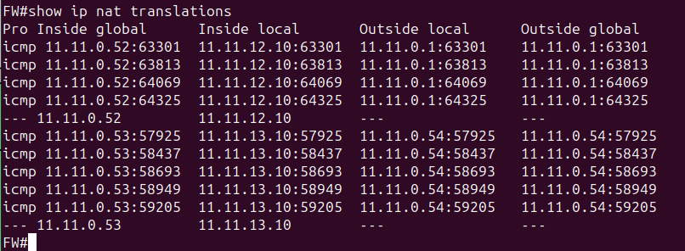
Network Address Translation (NAT)

Slide 7
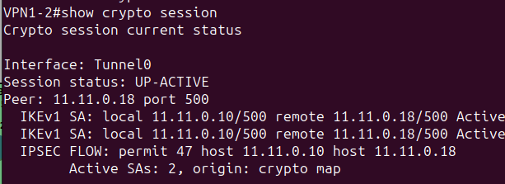
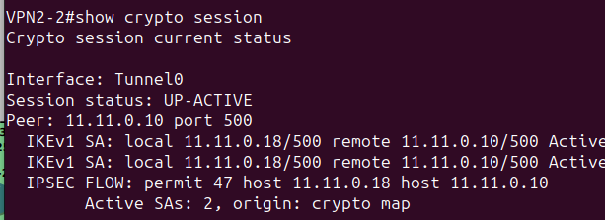
Protected GRE Over IPSec Tunnels

Slide 8
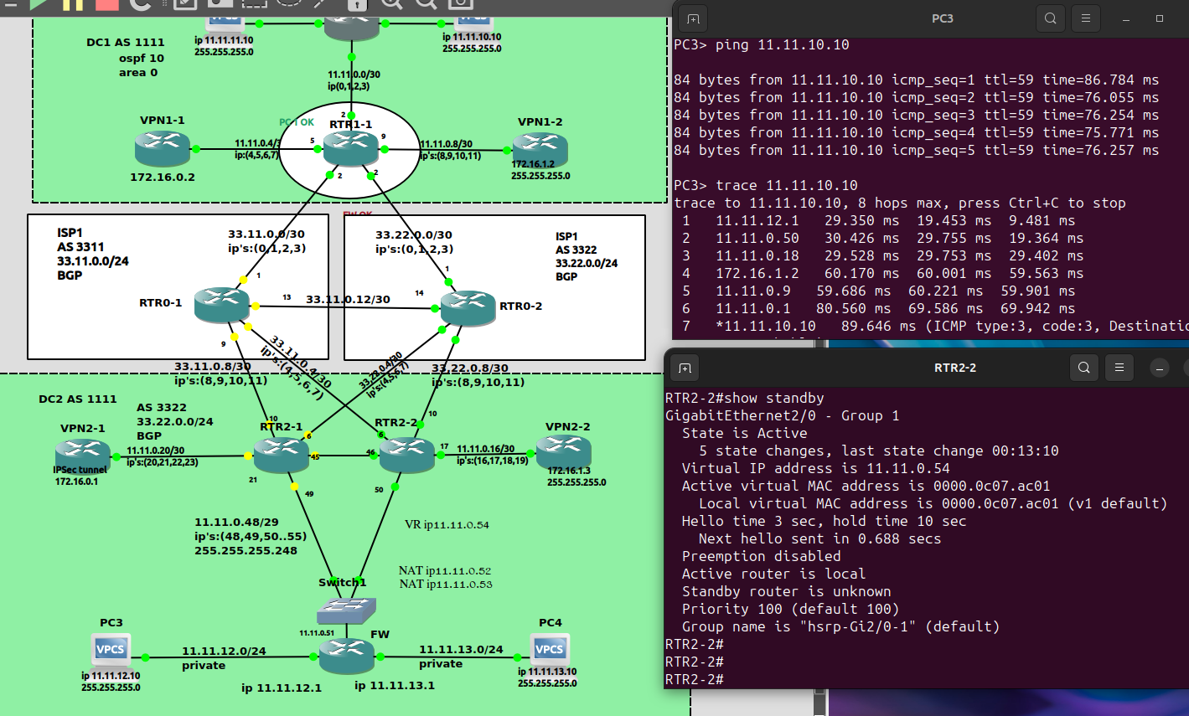
Crash test #1 when some Routers are not working

Slide 9
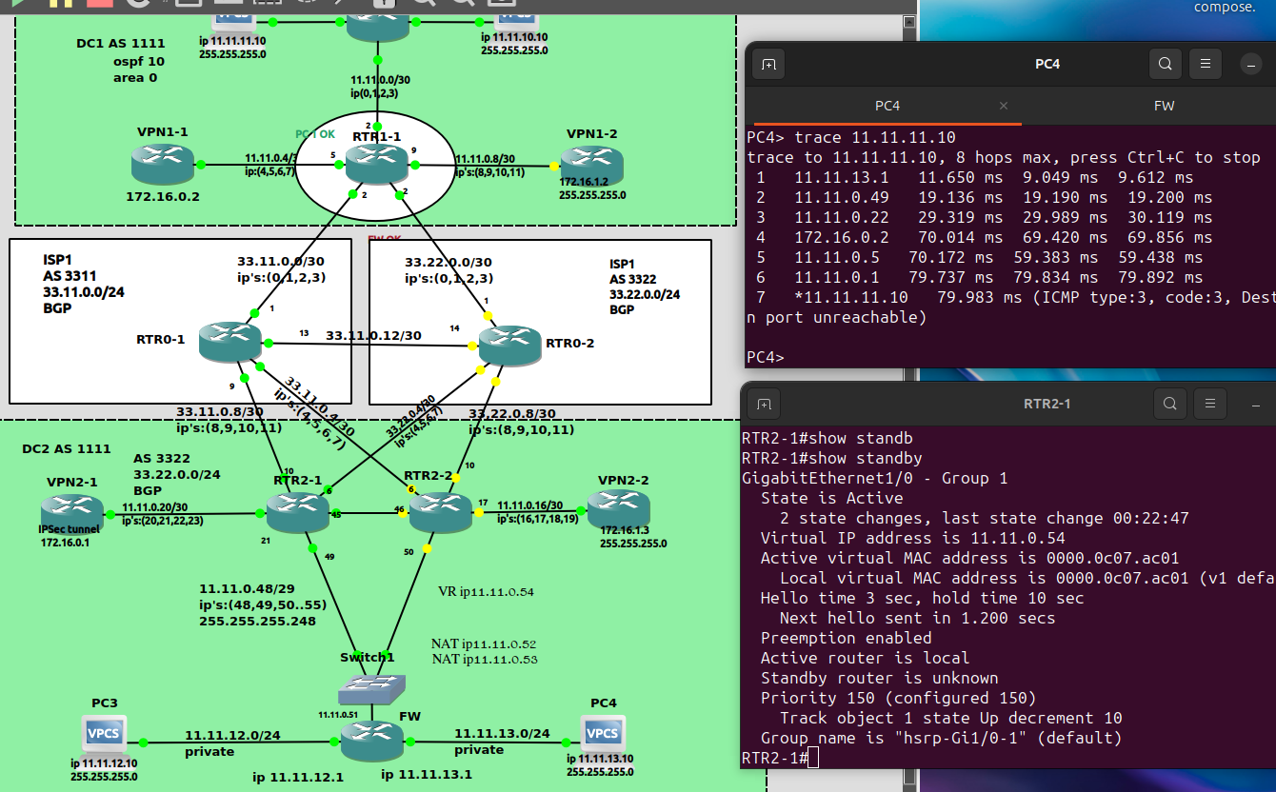
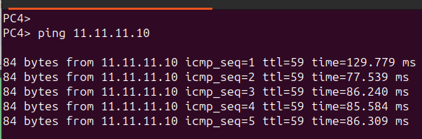
Crash test #2 when some Routers are not working

